Slide 1

Group 1: Customer Feedback
Zachary Chipman
Andrew Dobkowski
Kevin Hager
Jennifer Han
Alison Reikher

Slide 2
Project Goal & Functional Requirements
Project Goal:
Build an integrated data warehouse between Fudgemart and Fudgeflix
Functional Requirements:
The business must be able to track the spending habits of its customers across the different parts of the business and their demographics.
The business must be able to track the length of time between the ordering and the shipping of products.
The business must be able to monitor and measure the perception of their products amongst both of their subsidiaries.
The business must be able to understand the internal expenses they are encountering.
Fudgeflix must the able to track the retention among current customers as well as tracking new subscriptions
Notes:
Kevin

Slide 3
Business Requirements
Sales. Evaluating and understanding the sales for both Fudgemart and Fudgeflix.
Order Fulfillment. Assess the efficiency of order fulfillment to better understand competency of Fudgemart and Fudgeflix shipping.
Customer Feedback. Understand customer’s experiences with Fudgemart and Fudgeflix products by gleaning valuable insight from the customer reviews left on said products.
Payroll. Assess the current Payroll expenses for Fudgemart and Fudgeflix.
Subscriptions. Look at the details of Fudgeflix’s monthly subscriptions as well as any changes to the number of subscribers and any change rates between different plans.
Notes:
Kevin

Slide 4
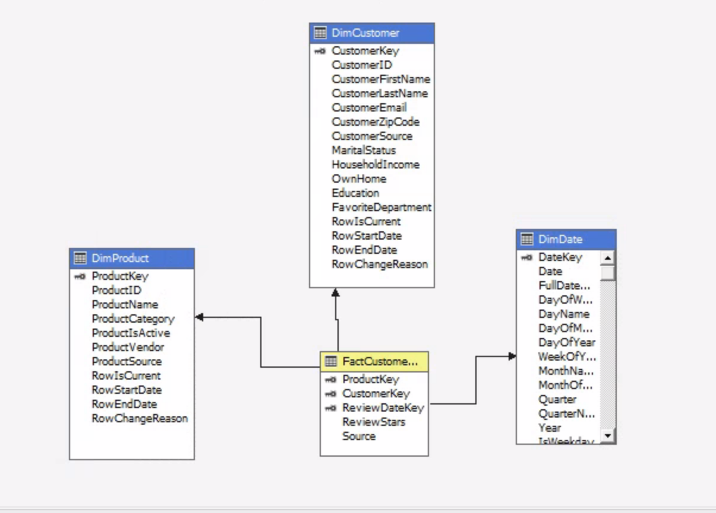
Business Process Selected & Star Schema
Customer Feedback: Understanding customer’s experiences with the products from both companies
Fact Table
FactCustomerFeedback
Fact Grain Type: Transaction
One row per product review
Facts
ReviewStars
Dimensions
Product
Customer
ReviewDate
Notes:
Alison

Slide 5
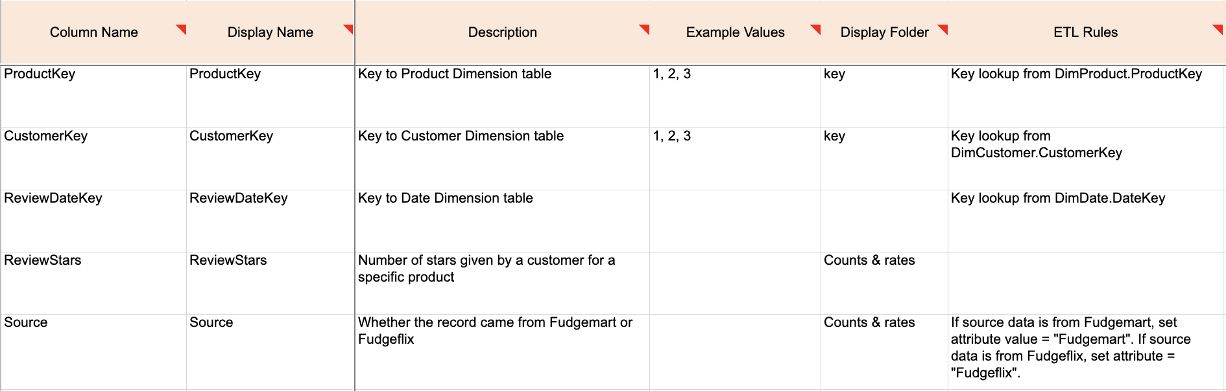
Merged Data Assumptions
How we chose to integrate customer and product dimension
Called titles from FF as products
Identified data columns that overlapped through data profiling
Assumed the account title return date is equivalent to the review date for Fudgeflix
Detail Dimension for FactCustomerFeedback

Slide 6
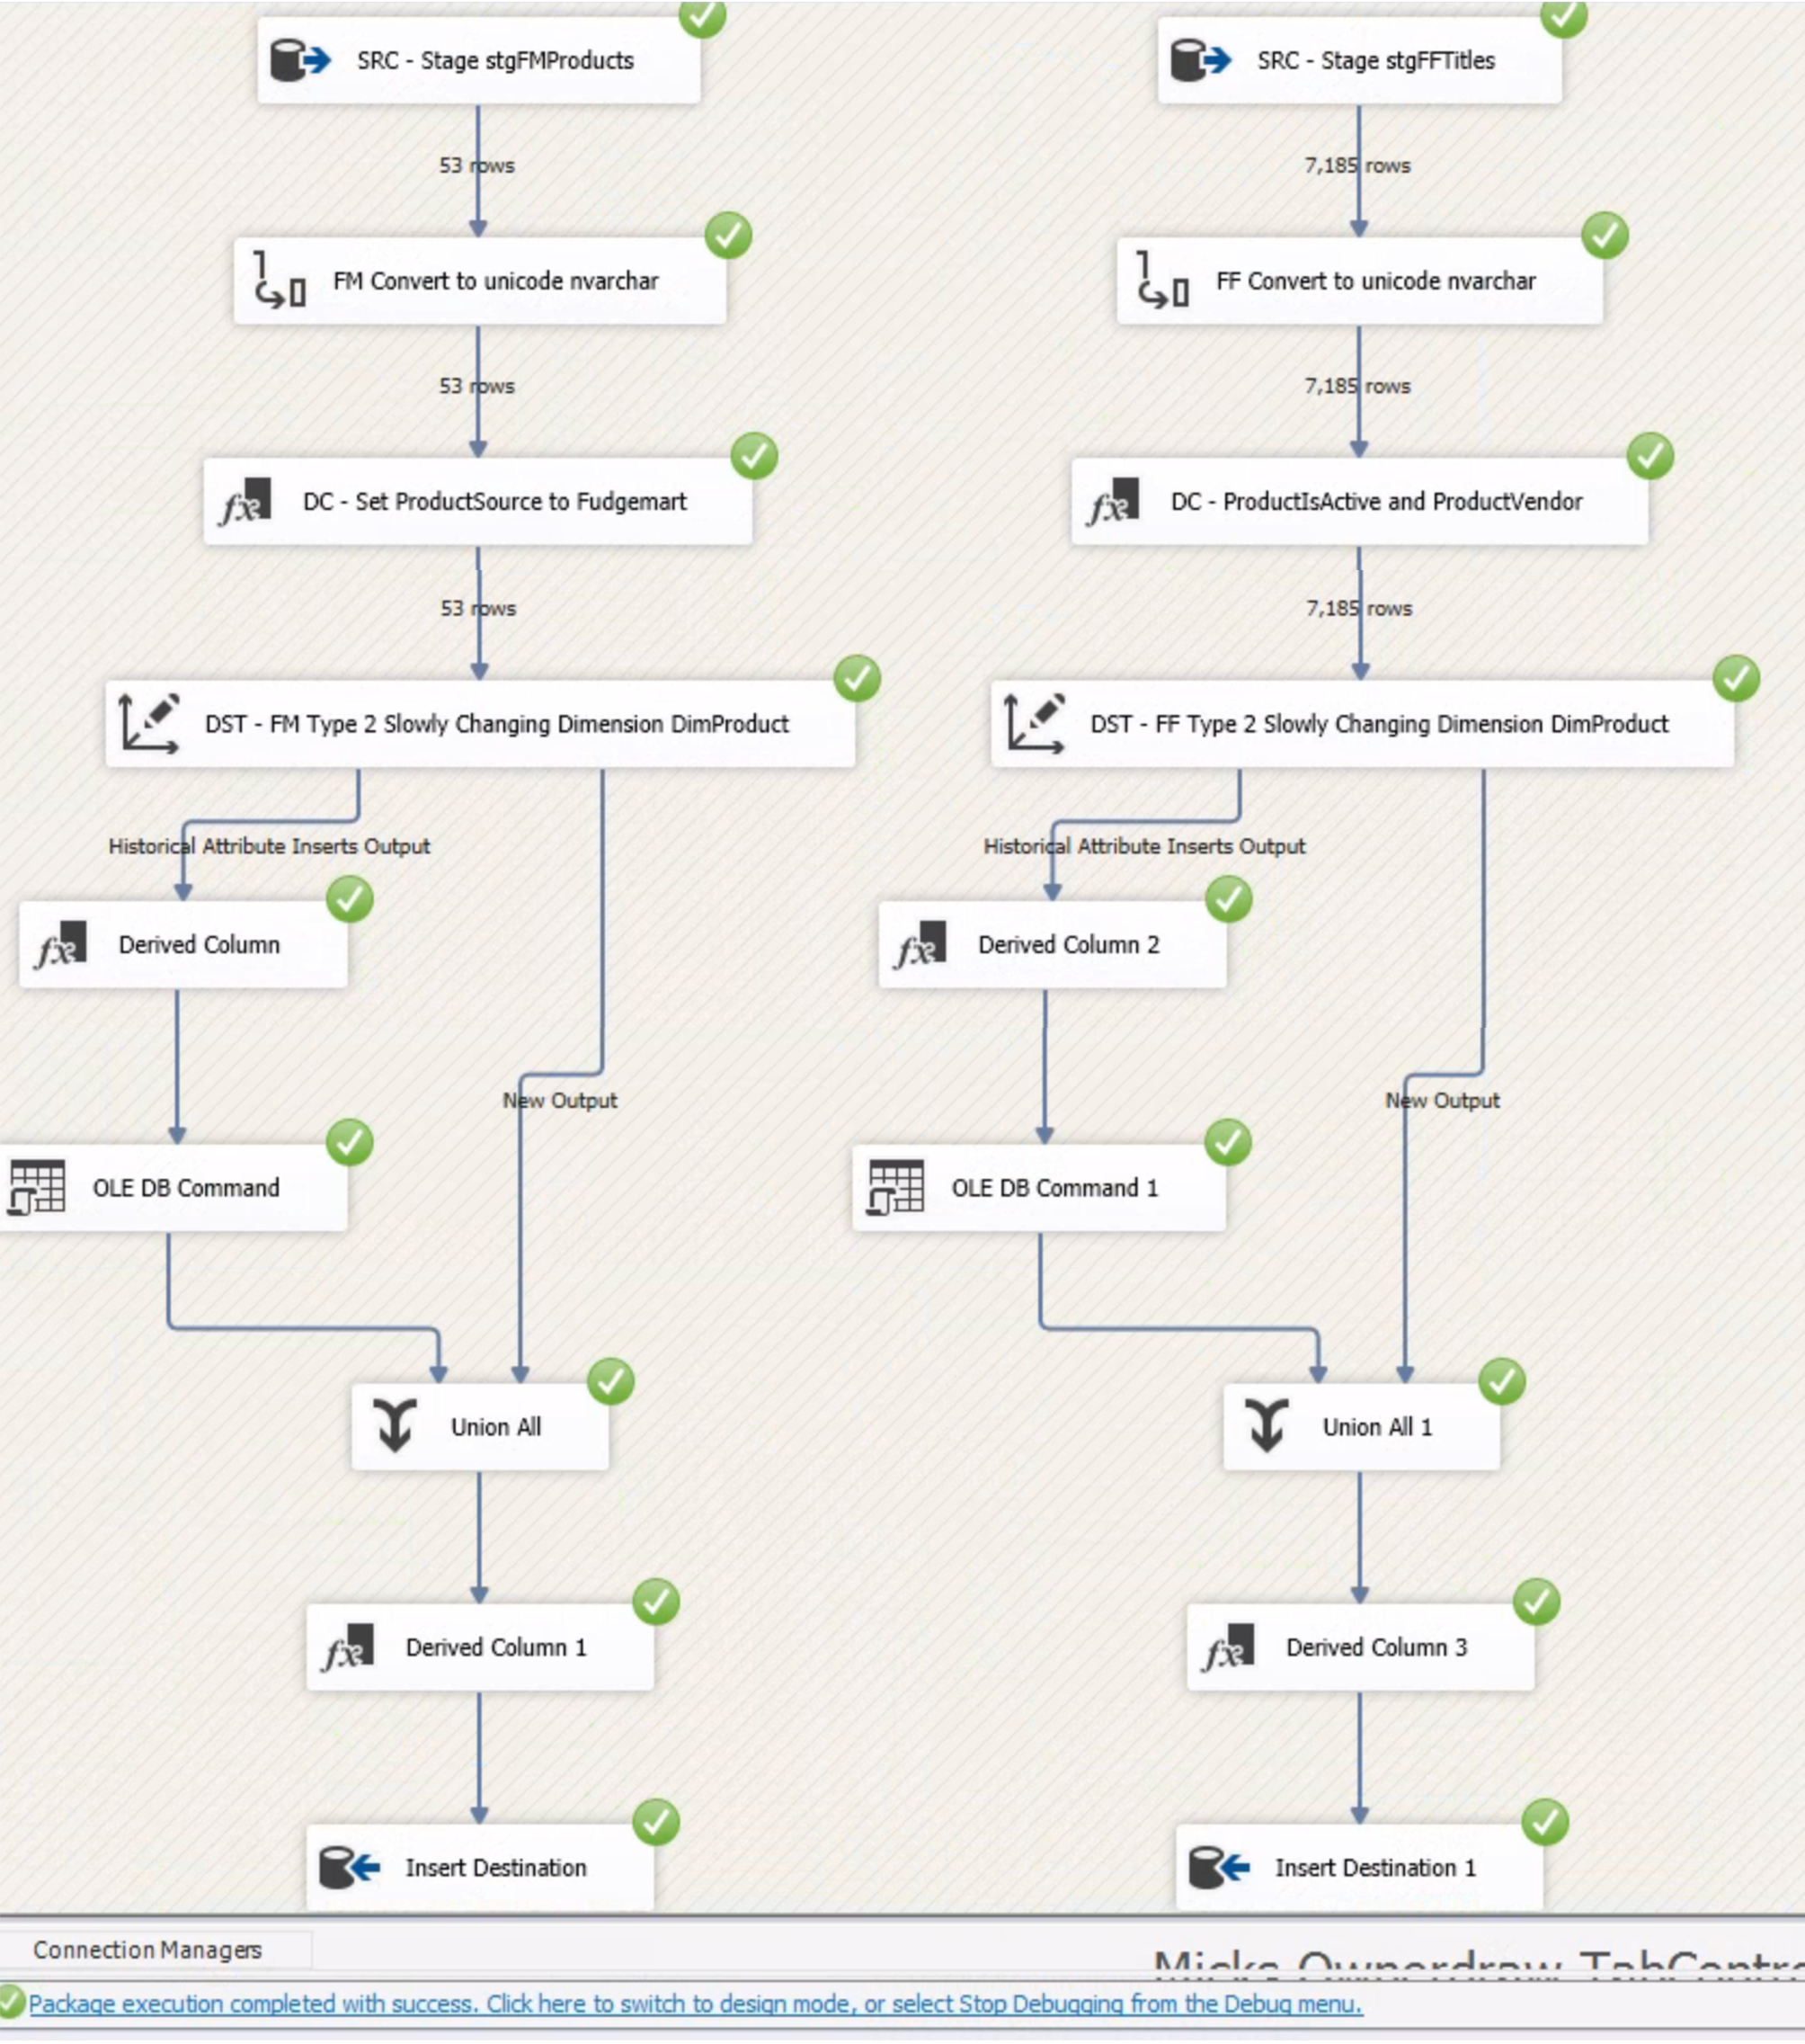
ETL Processes and Assumptions
Noteworthy transformations:
Varchar to nvarchar conversions (string to unicode string)
Product Dimension: IsProductActive set to False for Fudgeflix titles when bluray_available, DVD_available, and instant_available all = 0.
Customer Dimension: Integrated Fudgemart Customer Survey data from the ExternalSources2 table, joining on email address
Customer Feedback Fact Table: Surrogate Key Lookup for CustomerKey needed to filter the Customer Dimension table to only rows that matched the Source:
For Fudgemart data: Join on CustomerID for ONLY rows where Source = “Fudgemart”
For Fudgeflix data: Join on CustomerID for ONLY rows where Source = “Fudgeflix”
Example: Products Dim Stage to DW ETL

Slide 7
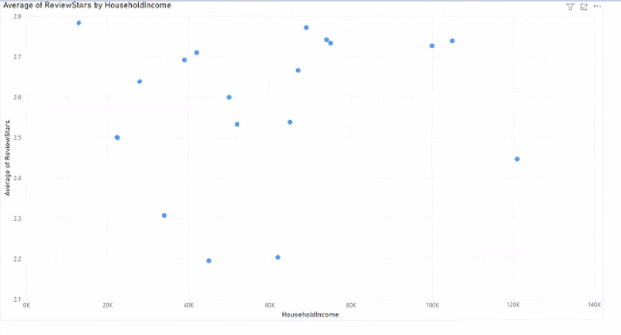
BI – Data Story

Slide 8
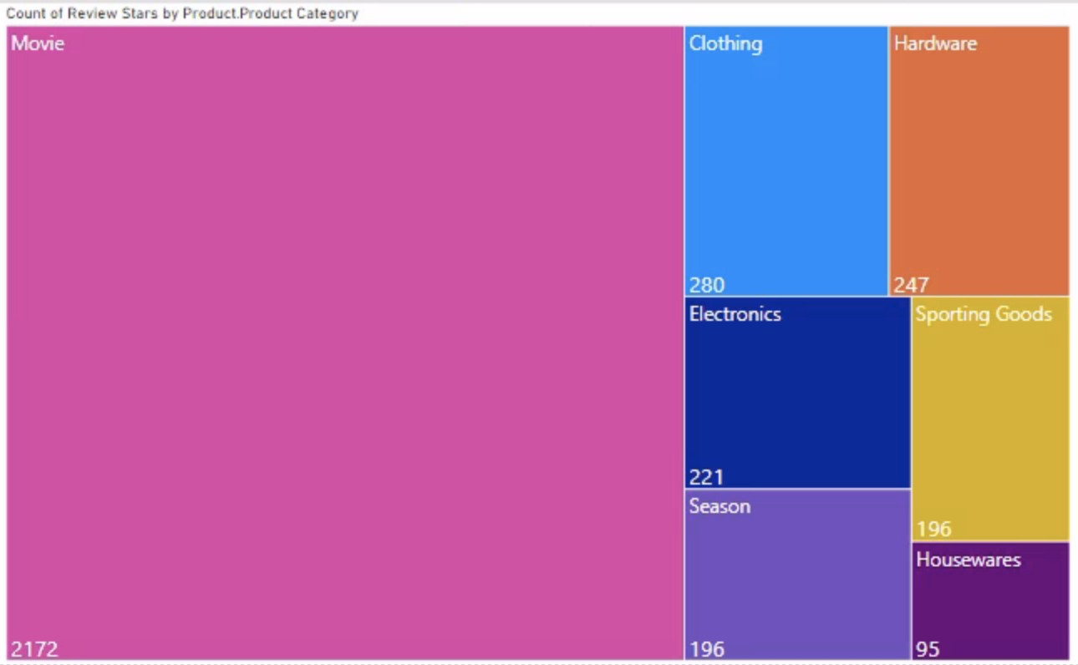
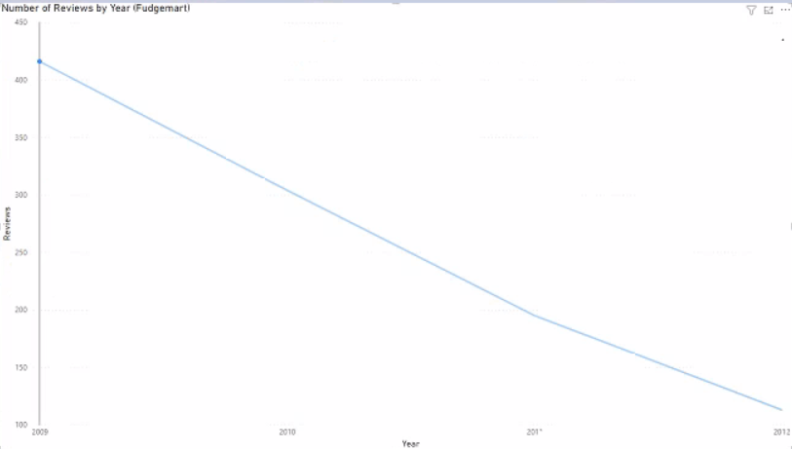
BI – Data Story (cont.)

Slide 9
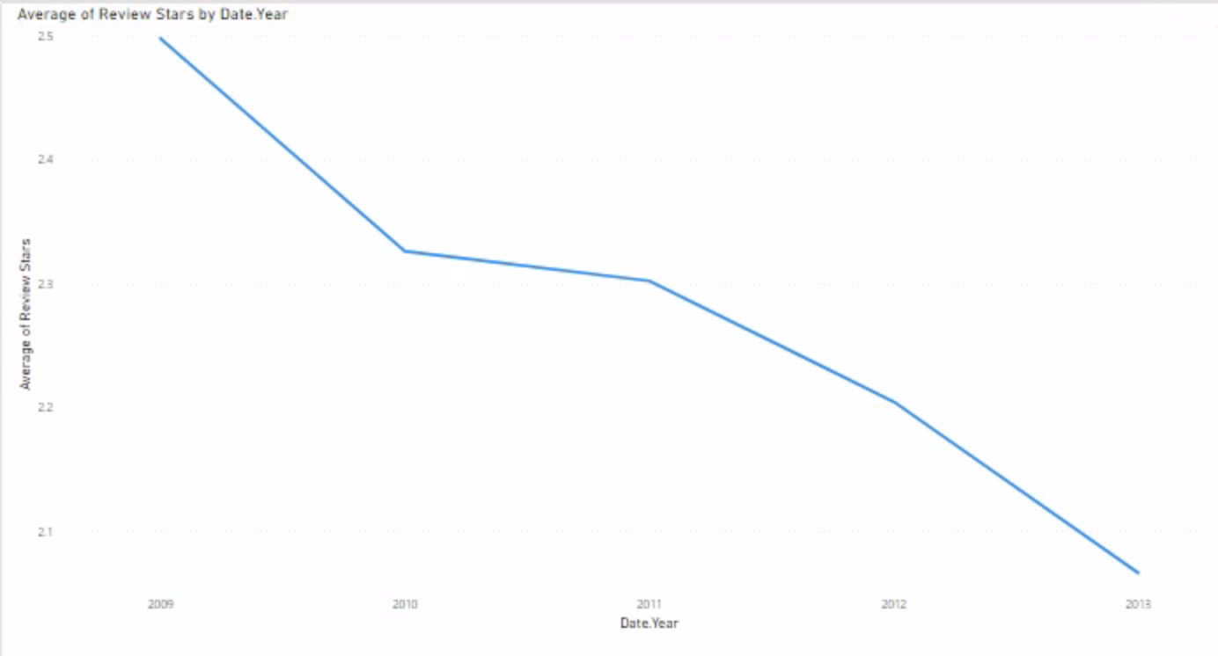
BI – Data Story (cont.)

Slide 10
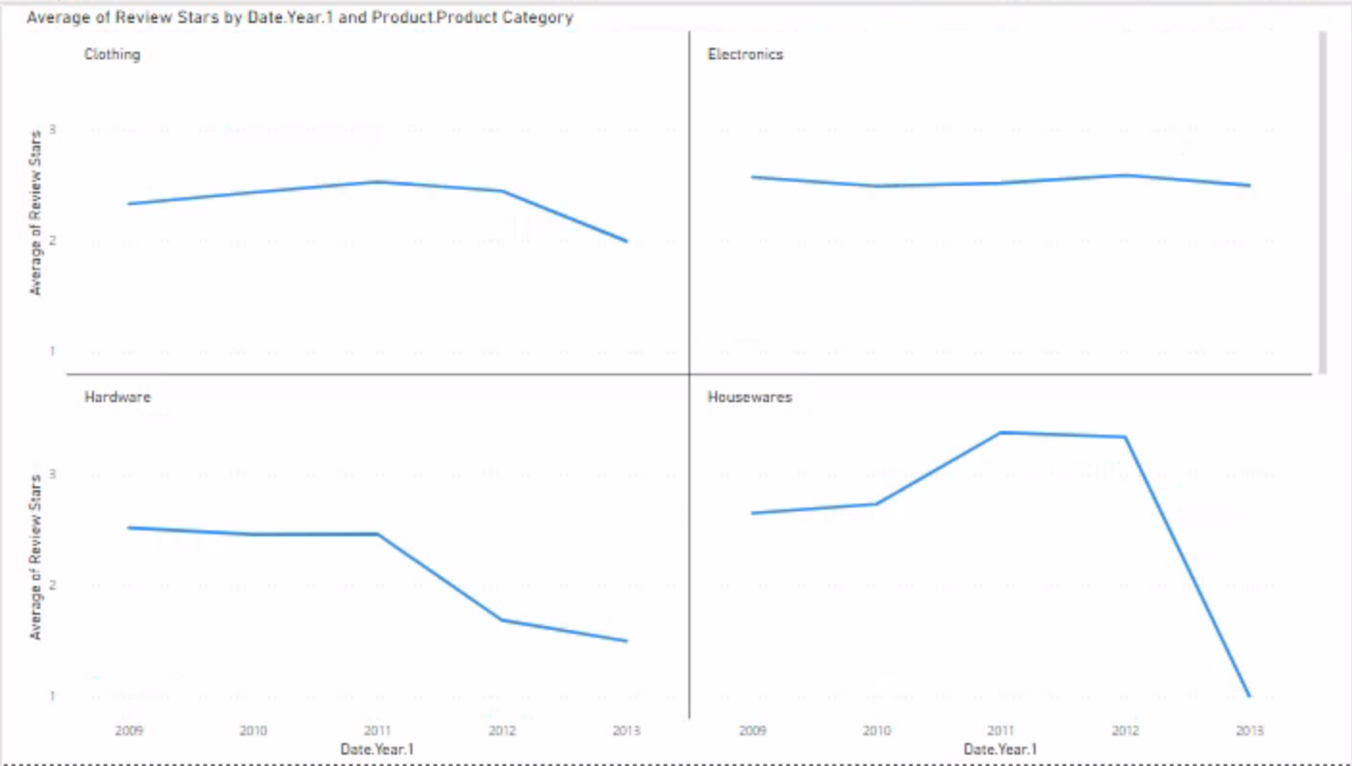
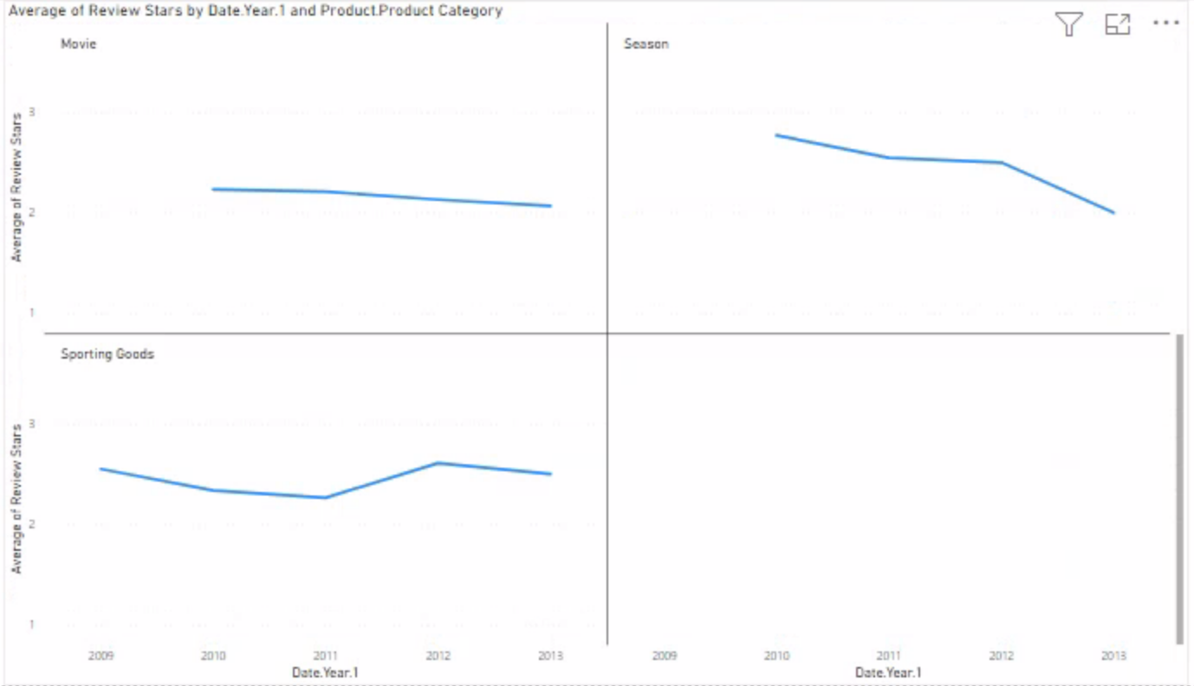
BI – Data Story (cont.)

Slide 11
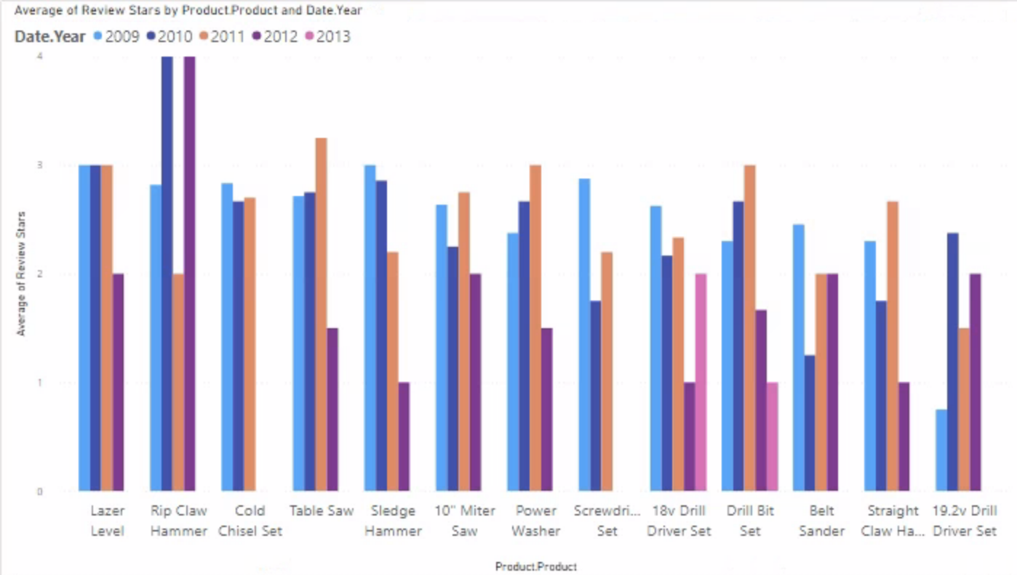
BI – Data Story (Cont.)

Slide 12
Recommendations and Conclusion
Meet with the Sales/Order Fulfillment Fact teams and address the decrease in Fudgemart reviews/review scores over time. Paying special attention to the decrease in Hardware scores from 2011-2012.
Continue to isolate products with low reviews. Analyze customer tweets for more detail.
Meet with corresponding vendors and employees (quality or marketing issue?).
Gather more data for 2013. One month is not enough data to compare with the other years.
More information from the OLTP owners would have also been appreciated.

Slide 13
Questions?

